Slide 1
Universal ETL Program Overview
Applied Definition Programming with Smart Components
C. Grant Anderson
March 30, 2018

Slide 2
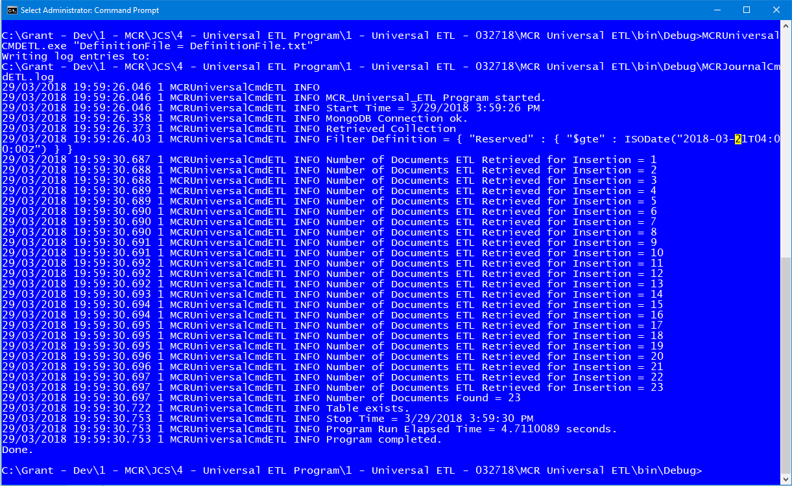
What’s the Universal ETL Program?
A command line ETL program…
Extract JSON documents from the a Cosmos DB NoSQL database…
Transforms and loads the data into SQL Server…
For reporting via SQL and Analysis Services tabular cubes.

Slide 3
What Does it Do?
Letters Universal ETL Program Operation
2. Universal ETL Program with Definition File for the Letters ETL.
Journal History Collection
ETL Program
Cube Database Table
1. Letters documents in the Journal History Collection
Definition File - Letters
3. Transformed data is loaded into SQL Server table ReportDatabase.stage.Letters

Slide 4
How is it Used?
The ETL Program grabs data from the Letters JSON documents in the Cosmos DB collection.
Transforms the data and inserts it into the Cube database tables in the ReportData data warehouse.
From there it is cubed in the cube.
And reports then use the cubed data for reporting.
Cube
Reports
Reports
Reports
Cube Database
SQL Server DB
Universal ETL Pgm
Journal History - Letters
Cosmos DB

Slide 5
Why Was it Built?
We needed to report on the Journal History data.
Microsoft’s ODBC SQL bridge driver did not work.
Commercial bridge drivers did not work either due to being on Azure Government.
The solution was to build a command line ETL program:
The CMD ETL Program.
Did it work?
Yes…But it would have to be cloned and modified for each and every other specific application scenario and instance.

Slide 6
The Better Longer Term Solution
What if we could write ONE ETL program…
And use it everywhere with just different configuration files?
This is exactly what the Universal ETL Program does.
Why not use SSIS?
SSIS requires C# scripting…
And doesn’t deploy properly when the JSON.NET library is used…
And doesn’t work better than just a direct C# program.
So the Universal ETL Program was developed.
Why keep on writing custom code when you can just make changes to a text based definition file?

Slide 7
What Problem Does it Solve?
The Journal History data…
And other data…
Is stored as JSON documents…
Not as relational database tables.
We can’t use SQL to report on it…
Nor directly cube it.
Getting the data into SQL Server is necessary to be able to report on it.
And put it into reporting cubes for advanced reporting.

Slide 8
How Does it Work?
Program
Definition File
Smart Component
Program
The Smart Modules contain advanced parsing and processing code in a framework organization.
Program actions are abstracted into Definitions and encoded into text Definition Files.
The Smart Modules read the Definition Files and do what they say.
The “Secret” of the Smart Modules is the high-level action abstractions in the code that requires a high cognitive visualization and modeling ability (Level 3 Cognition Level of Triality Theory).
Instead of trying to “nail jelly to a tree” with procedural code Smart Modules use higher level internal programming constructs to create an action framework that does the work that the Definition Files tell it too.
And, yes, the Definition Files can be stored in a database or two for enterprise wide coverage…And easy updating.
Internal
Advanced Data Structures
Definition File Parsing
Action
Framework Functions
Program Actions Engine
Program Actions
Data Source
Data Processing and Transforms
Data Destination

Slide 9
Quick Primer – Definition Programming
With Smart Components

Slide 10
What is Definition Programming?
A New Paradigm…
Take the base definition of what a program does…
Out of the code itself…
And put it into a human readable & understandable & editable text file…
A Definition File.
That defines what the program needs to do…
Without coding.
Why Code when you can just Define?
With Conventional Procedural Programming:
Procedural Code
Procedural Code
The Program Definition…What it does…Is intricately embedded with custom procedural code.
Procedural Code
Program
Definition
So you’re CONTINUALLY:
Making changes to it to change the definition including the business logic.
Making clone copies and variants of it to solve the same problems over and over again…
And it just gets more and more complex and hard to manage!
With the New Definition Programming Paradigm:
Procedural Code
Smart Component
Program
Program
Definition
2. And put it into a text file that anyone can read and write…
1. Extract the Program Definition out of the mess of the procedural code…
3. And use it to drive a universal smart component program.

Slide 11
What is Conventional Procedural Code?
It’s code that you have to write and compile and deploy…Over and over again.
It’s custom written by hordes of programmers who are actually doing just about the exact same things with small variations…Over and over again.
The same “solutions” are invented and re-invented over and over again by many people…But they are never simplified and standardized into components.
Programmers just keep writing more and more code…
More complexity…More code…And it never ends…

Slide 12
The Conventional Procedural Programming Paradigm
Note that in this context we’re using the term “Procedural Programming” to mean the variations of the conventional programming paradigm – Imperative, Procedural, Functional, etc:
You write a lot of code statements…
You compile them…
You deploy them…
The code statements your write is the sum total of the “procedures” to get what you need…
This includes such variations as:
Imperative Programming
Functional Programming
Object Oriented Programming

Slide 13
What’s Wrong with Conventional Programming?
Very limited ability to fully modularized code…And re-use it elsewhere.
Code complexity is not “collapsed” into simpler reusable modules.
Code becomes like writing a novel…Just write more and more code!
“I didn’t have time to write you a short letter so I wrote you a long one.” - Mark Twain
We don’t have Software Factories building and assembling software system component modules…
We have software sweat shops cranking out one of a kind pieces of code that don’t connect well with other pieces…
And just keeps on getting more and more complex.
That’s great if you get paid by the hour…
But it’s very bad for the companies and the industry that just want things to work quickly and easily…And long term.

Slide 14
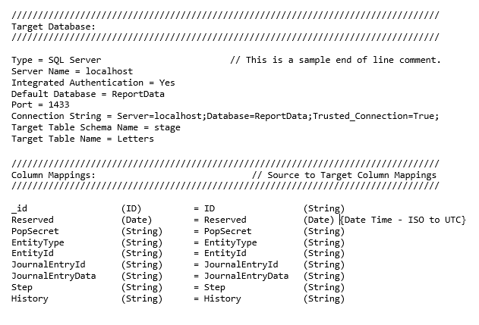
How is Definition Programming Better?
Smart Program Component Modules do all the hard work…
Once built you just use and reuse them everywhere you can without touching their code.
To use them you don’t procedural code…
You just write or edit TEXT Definition Files…
The Definition Files tell
the Smart Components
what to do.
Without programming!

Slide 15
What’s a Smart Module?
A Smart Module is an advanced software program that:
Reads in a Definition File
To determine what it should do.
It’s a highly abstracted flexible and powerful framework.
Rather than a mess of procedural spaghetti code that is written differently by each and every programmer.
Smart Modules are ENGINEERED…Not written like a novel.
Different Smart Modules do different things…
Just pick the one you need…

Slide 16
Where and How it can be Used
Anywhere a data processing process can be automated and defined…

Slide 17
How Does this All Work Together?
Image that you have a new business need to develop a file processing system that:
Automatically detects new files when they are SFTP’d in…
Loads the files and processes them according to a set of business rules…
Extracts their data and loads it into a database for reporting…
Simple, right?
But…How do you implement such a system?

Slide 18
The Old Procedural Coding Way
You get a bunch of developers together…
And they start writing custom procedural code programs:
File Detection – Python or C#
File Handling – Azure functions
Database Loading - SSIS
Business Rules – SQL Server Stored Procedures
Reporting – SQL, Excel, Tabular Cubes
And you’ve got a lot of different code in a lot of different languages in a lot of different environments…
And how long does it take to write all this code?

Slide 19
The New Smart Module Way
You select and install 3 Smart Modules:
File Processing
Business Rules Engine
Report Generator
You then edit the Definition Files for each using an easy to use GUI editor with wizard.
You start running data through it…
While monitoring the data flows through the built in logging and Smart Real Time Dashboard that each Smart Module intrinsically supports.
Not bad for a single day’s work…

Slide 20
How to Get There?
Grant has been pioneering this at his last several jobs…
He’s built several modules:
File Import Service Module
Business Rules Engine
Data Transport Module
Now he’s produced a Universal ETL Program that is the core of an ETL Smart Module.
He is producing a short introductory book this year on “Definition Programming with Smart Modules” which will include several open source examples.
Definition Programming will take some time to catch on…
And a base set of Smart Modules needs to be created first.
So it’s not going to be an overnight revolution.
But slowly and surely it will start to eat away at custom procedural coding…

Slide 21
How and Where Can It Be Used?
While it will not replace all procedural programming it will chip away at it year after year in a growing number of application scenarios:
ETL…
Data Transport and Transformation between databases…
File Data Loading…
Business Rule Data Transformation…
Business Processes…
And even Web Sites…
And some GUI programs as well..
And since the Definition Files are universal…
It’s inherently cross platform and Cloud ready with cross platform modules on each platform…
Each year it will grab a bit more of the software marketplace…
And software will get EASIER to write instead of harder.

Slide 22
How Can a Company Leverage It?
The Universal ETL Program is a great start.
See where it can be expanded and used elsewhere.
Consider building Smart Modules due to the competitive advantages.
Every competitor uses the same:
Languages
Code Libraries
Software Technology and Clouds
It’s a level playing field competing on price and
“Our developers are better than your developers!”
Why not consider Smart Modules and Definition Programming as a competitive advantage?
Software systems in days instead of months…
With a fraction of the programmers…
At a very competitive price…
And much higher profit.

Slide 23

Thanks for Listening!

